Slide 1
Blockchain Based Document Vault : VeriFicate
By:
Yogesh Gupta, Shiv Kumar Rathore & Tushar Tomar

Slide 2
INTRODUCTION
This educational records project utilizes blockchain for secure storage and sharing. Blockchain ensures data reliability, with off-chain encrypted records and hash information anchored for protection. Cryptography manages encryption and digital signatures, complemented by a WebApp interface for decentralized communication.

Slide 3
AIM
Secure and Private Educational Record Storage:
Ensure confidentiality and integrity in secure and private educational record storage.
Efficient Blockchain-based Data Sharing:
Streamline and secure educational data exchange through efficient blockchain-based data sharing.
User-Friendly Decentralized Record Management:
Provide an intuitive interface for decentralized record management, enhancing user-friendly access.

Slide 4
Literature Survey
A Blockchain-Based Educational Records Secure Storage and Sharing Scheme
Hongzhi Li, Dezhi Han
Document Verification Using Blockchain
Ashish Zende, Lalit Amrutkar, Nayan Kadam, Prof. S. P. Baman

Slide 5
CHALLENGES
Browser Compatibility: Compatibility across different web browsers posed a challenge, as the project relied upon specific features of metamask extension that behaved differently across browsers.
Performance: Ensuring that the frontend operates efficiently and responds promptly to user interactions, even when interacting with the blockchain, was a concern. Slow loading times or lag in transactions can deter users.
Security: Implementing security measures in the frontend to protect user data and private keys was critical. Failing to do so could expose users to risks like unauthorized access and data breaches.

Slide 6
Requirements
Hardware
Blockchain Nodes
High-Performance Servers
Printers and Scanners
Software
Blockchain Framework
Smart Contract Development Tools
Database Management System

Slide 7
Project’s Workflow

Slide 8
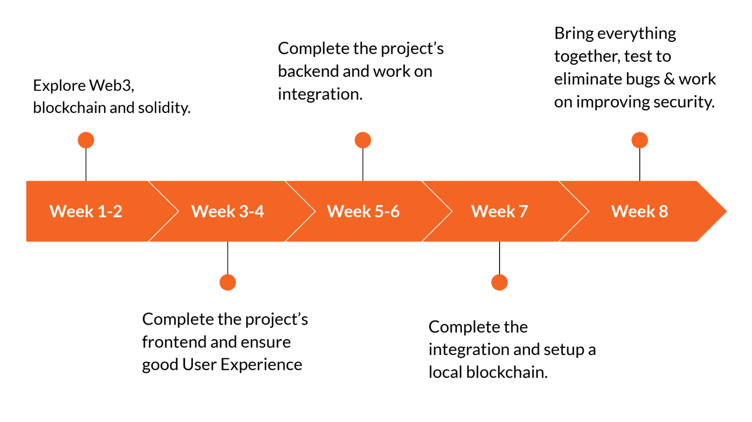
A report with location and product info is generated that is then shared with the manufacturer.
Anyone who is buying the product can verify it’s authenticity using a QR present on the label.
Manufacturer registers the product and sells it to the seller.
Product Registration
Blockchain Authentication
Product Verification
Alerts for Counterfeit Detection
Sending Report to Manufacturer
Product registration and sale is authenticated using a blockchain.
If product is a counterfeit, the customer gets notified.

Slide 9
THANK
ANY
YOU
QUESTIONS?

